Slide 1


DECEMBER 2024 COMMISSIONING CEREMONY
The University of Texas at San Antonio
Air Force ROTC Detachment 842

Slide 2
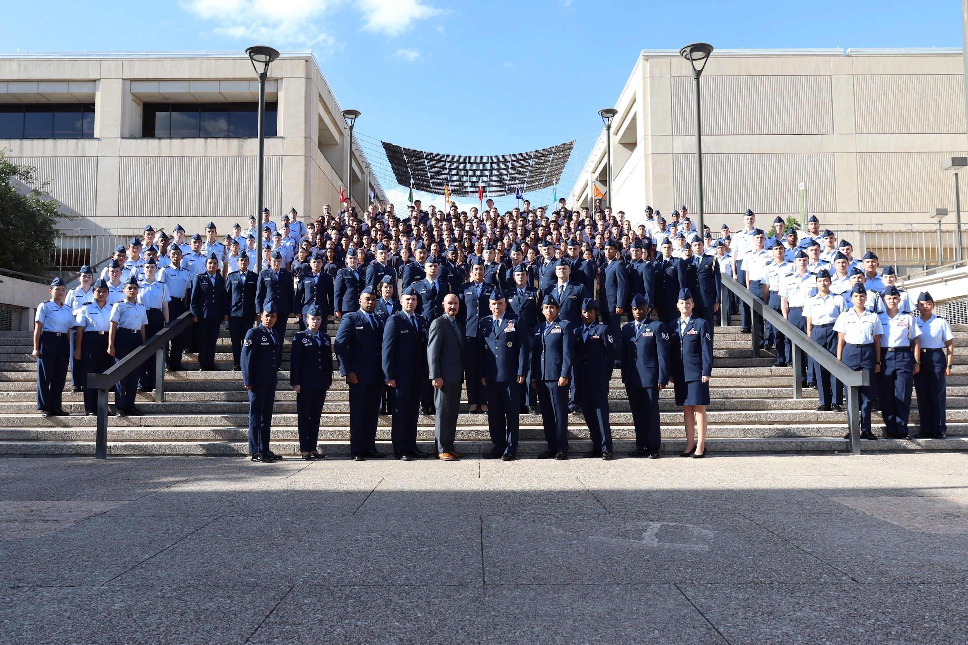
Det 842 – Best in Blue

